Slide 1
Team 1
Process Improvement for Health Information Exchange in Global Health
David Tsao, Lisa Murie, Seth Edmunds, Dustin Palmer, Peter Hicks

Slide 2
Goal
Increase the utility of patient-level information for public health decision making.
Promote semantic interoperability

Slide 3
Public Health Context
Ministries of Health: Health Information Systems (HIS)
Collect patient clinical information at service delivery points.
Current case surveillance is a parallel and/or manual process.
The Health Informatics Team in the Division of Global HIV and TB
Adopt approaches that systematically reuses existing HIS data for HIV case surveillance.
Case reports (HL7 Clinical Document Architecture) are sent from an existing HIS to a central repository through health information exchange (openHIE) for surveillance purposes.

Slide 4
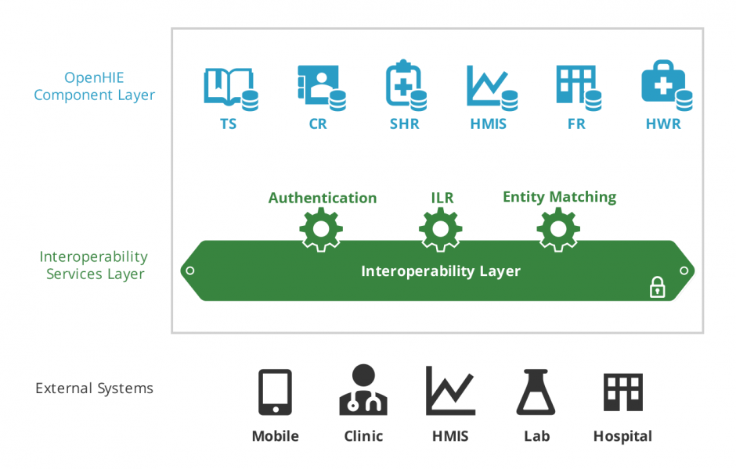
openHIE Architecture: An overview

Slide 5
Current challenges
The current process of validating case reports is cumbersome.
No structured storage for case reports.
Surveillance officer has limited ability to query and visualize case reports. Current process is inefficient.

Slide 6
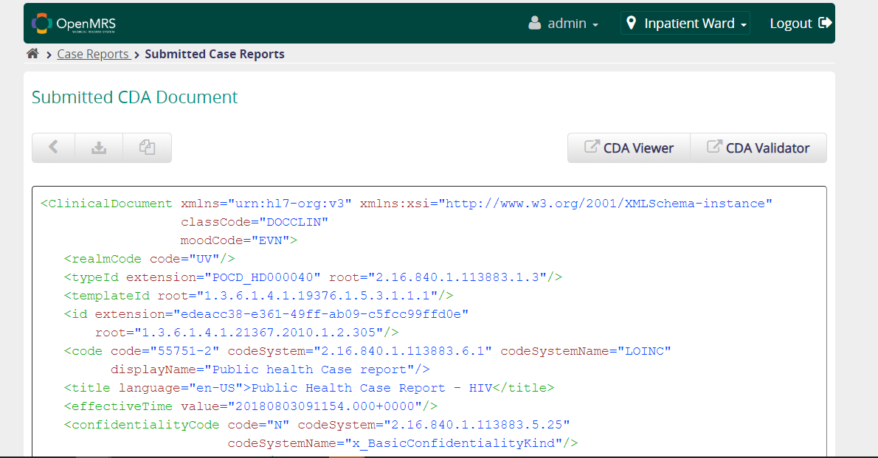
Current validation process: manual

Slide 7
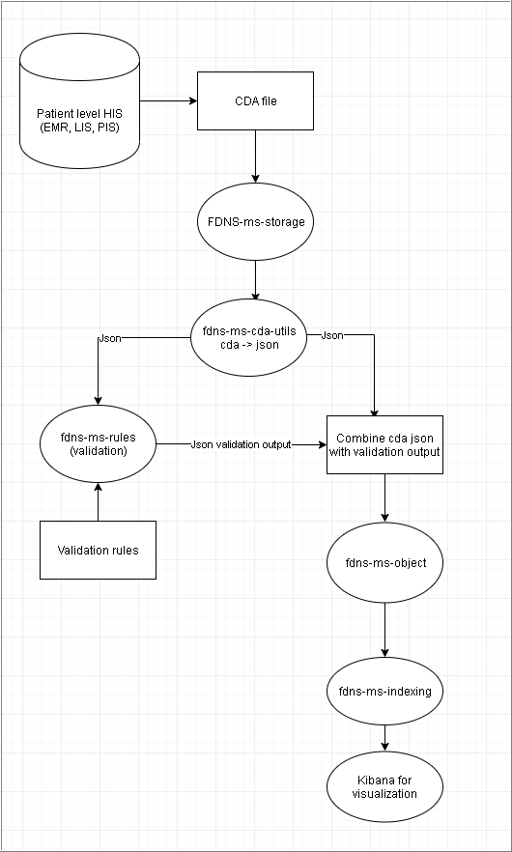
Hackathon process
Upload collection of CDA files into fdns-ms-storage
Create Drawers for Team1
Create Nodes for each document
Transform CDA to JSON file using fdns-ms-cda-utils
Validating CDA using fdns-ms-rules
Create a config file with validation rule conditions to load into the service (used JSON Path Online Evaluator)
Validate JSON against the rules using service
Store validated JSON in fdns-ms-object
Pass validated JSON into fdns-ms-indexing
This would then be used to interface with other HIS via api endpoints

Slide 8
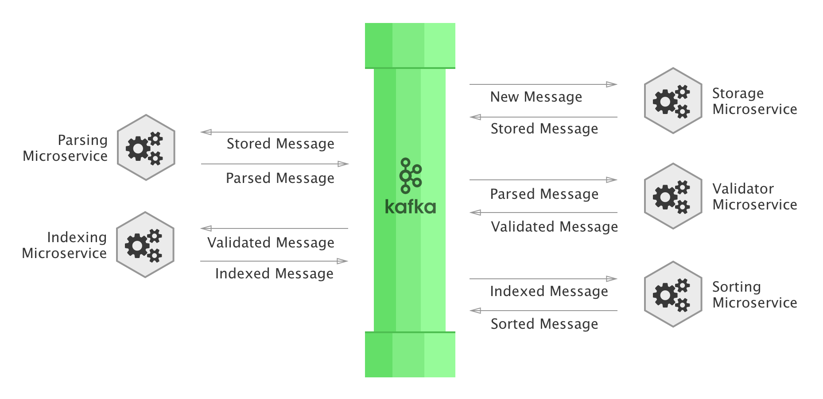


Wish List
FDNS-MS-CDA-UTILS should
Validate HL7 CDA documents
Convert HL7 CDA to FHIR resources so that we could reuse existing FHIR json validators
Use Kafka pipeline to orchestrate this process
Provide additional documentation and “how-to” guide for using the existing foundation services.
Summer 2018 v6
Notes:
Docker: Docker is a software technology providing operating-system-level virtualization also known as containers
GitLab: GitLab is a web-based Git repository manager with wiki and issue tracking features, using an open source license
Jenkins: Jenkins is an open source automation server written in Java. Jenkins helps to automate the non-human part of software development process, with continuous integration and facilitating technical aspects of continuous delivery.

Slide 9
Questions?

Slide 10


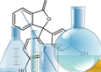
HIE essentials for HIV case surveillance
Secure data exchange
surveillance
data repository
Client
Testing
Care
laboratory
Client registry
Person matching
Interoperability
Service
Clinical Data Store
ADX
Indicator
data repository
Longitudinal Record
Health services documentation
Trigger and dataset definitions

